Slide 1
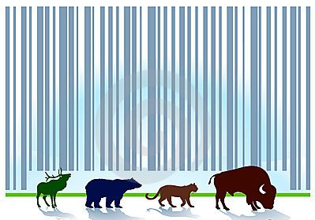
WILDLIFE FORENSIC
- HETAL DEDHIA

Slide 2
Introduction to Wildlife
Wildlife means all the flora and fauna, which are not domesticated by humans. It includes animals, plants and microorganisms.
Due to its faunal and floral diversity, India is recognized as one of the seventeen mega bio-diversity countries in the world on the basis of immense species diversity present.
However, our flora and fauna are threatened to a large extent by human activities like hunting, habitat loss, fragmentation and degradation, resulting in their population declines and range contractions of several species in Asia (IUCN, 2010)
There are 172, or 2.9%, of IUCN-designated threatened species in India. Under this comes the Asiatic Lion, the Indian white-romped vultures and the Bengal Tiger.

Slide 3
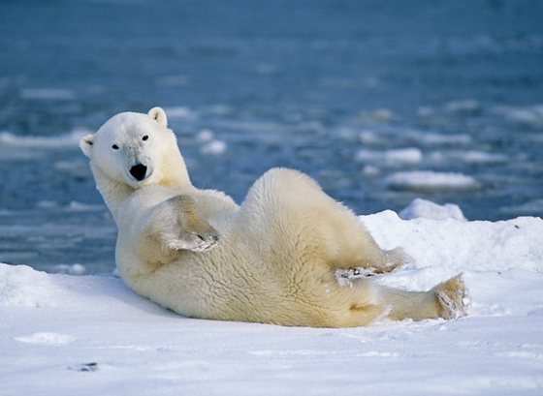
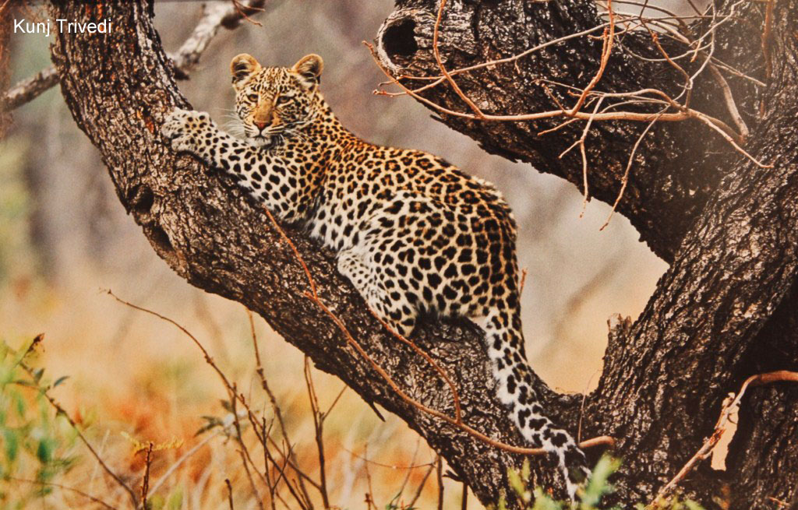
Importance of wildlife
Wildlife is important for four main reasons:
Aesthetic/ Recreational significance : By their unique way of existence, wild creatures exaggerate the natural beauty of the earth. Economic value: The financial value of wild species is important to the economies of several nations, as it provides many valuable substances like wood and other plant products, fibers, meat and other foods, and skins and furs. Scientific value: By studying wildlife, scientists have gained valuable knowledge about various life processes and discovered important medical products Ecological value : Wildlife helps in maintaining the balance among living systems of earth, which consequently ensures survival of life.

Slide 4
Wildlife Forensic/ Human Forensic
As in any police crime laboratory, forensic experts are expected to do two things :
-Identify the evidence
-Link suspect, victim and crime scene together with the evidence.
Victim is the animal
A large number of species required to be identified
Wide variety of standardization protocols need to be developed

Slide 5
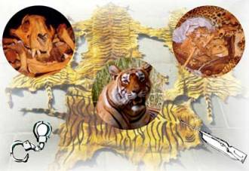
Wildlife Offences

Slide 6
One major factor threatening the very existence of some important species of wildlife is wildlife trafficking - the green crime of poaching that has branched out into collection, possession, processing, and importing of a large number of species for monetary gains.
This black market of wildlife is valued as the third largest illegal trade in the world and one of the most profitable crimes of today. The illegal wildlife trade is estimated to be valued somewhere between $10 and $20 billion .
The Wild Life (Protection) Act, 1972 was enacted to give proper shape, support and protection to wildlife conservation in the country. It has six schedules listing varying degrees of protection, with more protection being provided under Schedule I and part II of schedule II with the highest penalties prescribed for offences.

Slide 7
Hunting Techniques
Hunting on foot at night using locally crafted muzzle loading guns is one of the most popular means because it is very efficient, though risky.
Water holes, fruiting trees and croplands bordering forests are favorite spots for stalking wildlife. Snares using telephone wires and automobile clutch cables are set on the forest path regularly used by the animal.
Poisoned water placed in broken earthen pots is another popular method for large carnivores that threaten livestock.
High voltage live electric wires connected to fences are used to eliminate elephants and pigs.
Also, jaw traps are used for hunting large carnivores like tigers
Dynamites are used to poach fish.

Slide 8
Species endangered due to poaching

Slide 9
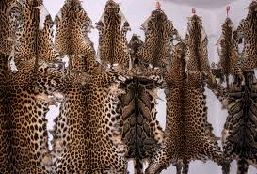
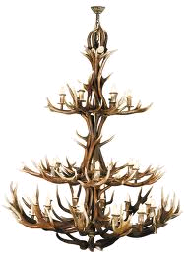
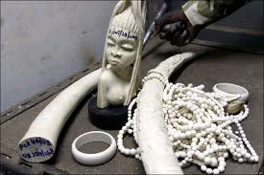
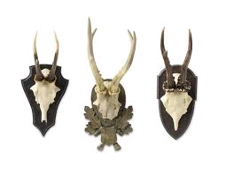
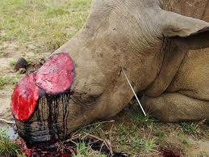
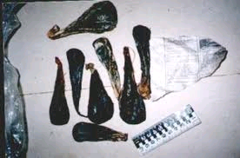
WILD LIFE TRADE
ANIMAL PARTS | USES
Musk pod | Perfumery
Ivory | Jewellery and Furniture
Hides of leopard, tiger and snake | Fashion products
Shahtoosh Hair | Shawls
Antlers and Horns | Jewellery and Furniture
Bear bile, bones and claws of leopard and tiger | TCM
Mongoose hair | Paint brush bristles

Slide 10
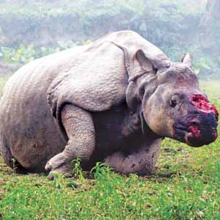
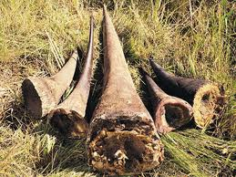
One horned Rhino
An adult rhinoceros in Africa, during his late night walk, falls in a perfectly dug pit lined with spikes to die a slow and painful death. Another rhino in India touches a cable wire that sends 11 kilowatts jolt through its massive body, electrocuting it. Their horns are pulled out. Price of each horn: US$450,000

Slide 11
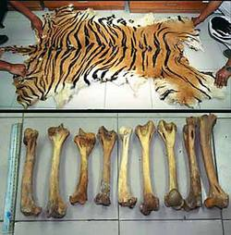
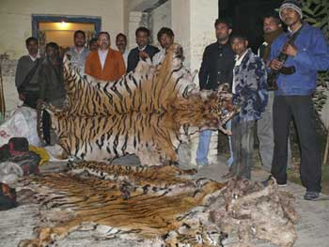
Tiger
Deep inside a tiger sanctuary, a carcass is laced with deadly poison as bait for the unsuspecting tiger. The tiger eats the dead meat only to die a painful and horrific death. Price: On Request – Because every little body part of tiger is shamefully high to quote.

Slide 12
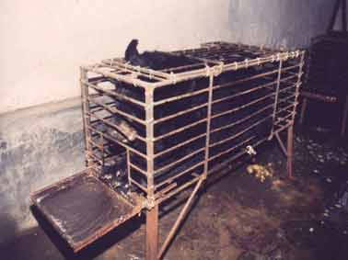
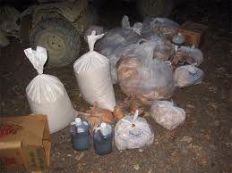
Black Bear
A Black Bear in a typically tiny cage on a bear bile farm. The bear cannot turn around, straighten up, stretch, or even shuffle a few inches backwards and forwards it's entire life. This cruelty is unthinkable, even without the extreme daily suffering the bear is forced to endure with the catheter that is inserted in to it's stomach, draining the bile out and leaving the bear vulnerable to deadly infection.

Slide 13
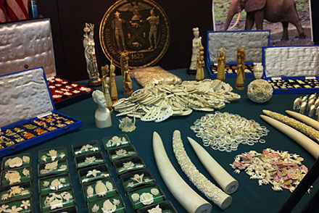
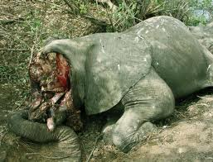
Elephant
Poachers kill elephants using methods such as stoning them to death, using a poisoned dart which results in a slow and excruciatingly painful death for the animal, and by shooting them with machine guns. Poachers slaughter entire herds of elephants when they gather to drink at waterholes.

Slide 14
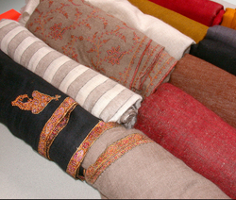
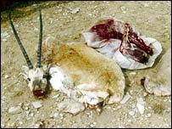
Tibetan Antelope (chiru)
About 20,000 chirus are killed every year to make Shahtoosh Shawls. i.e. 3-4 antelopes to make one shawl fetching lakhs of rupees in international market. Chirus are found in regions of Tibet, China, Kashmir and Ladakh at an altitude of over 3700 – 5000 meters. The ban on Shahtoosh trading has hit an industry worth $160 million affecting the livelihood of 30,000 workers.

Slide 15
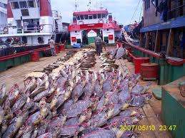
Olive Ridley Turtle
The beach of Orissa’s Bhitarkanika Marine Sanctuary is the largest mass nesting site of the Olive Ridley in the world. India could not enforce protection laws due to lack of funds. Ridley turtles are killed for their meat and leather. More than I lakh turtles have been killed during the last decade in Orissa.

Slide 16
Identification of skin and fur
Every year, the global leather industry slaughters more than a billion animals and tans their skins and hides.
Most leather produced and sold is made from the skins of cattle and calves, but leather is also made from horses, sheep, lambs, goats, and pigs who are slaughtered for meat. Other species are hunted and killed specifically for their skins, including zebras, bison, water buffaloes, boars, kangaroos, elephants, eels, sharks, dolphins, seals, walruses, frogs, turtles, crocodiles, lizards, and snakes.
Kangaroos are slaughtered by the millions every year, their skins considered to be prime material for soccer shoes.
Snakes and lizards may be skinned alive because of the belief that live flaying imparts suppleness to the finished leather.
Kid goats may be boiled alive to make kid gloves, and the skins of unborn calves and lambs—some purposely aborted, others from slaughtered pregnant cows and ewes—are considered especially “luxurious.”

Slide 17

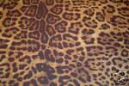
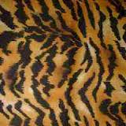

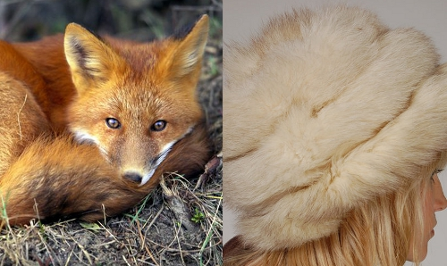
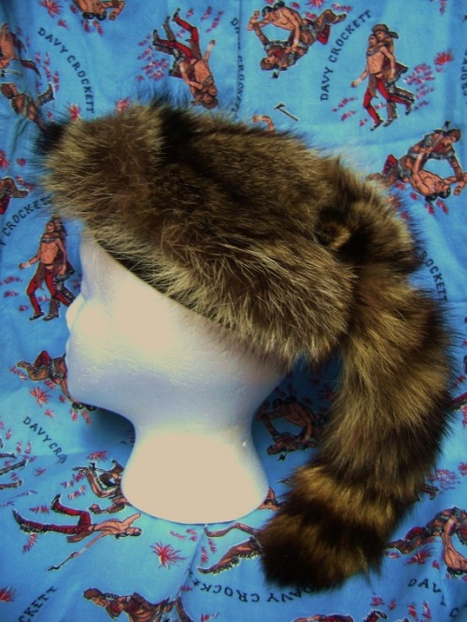
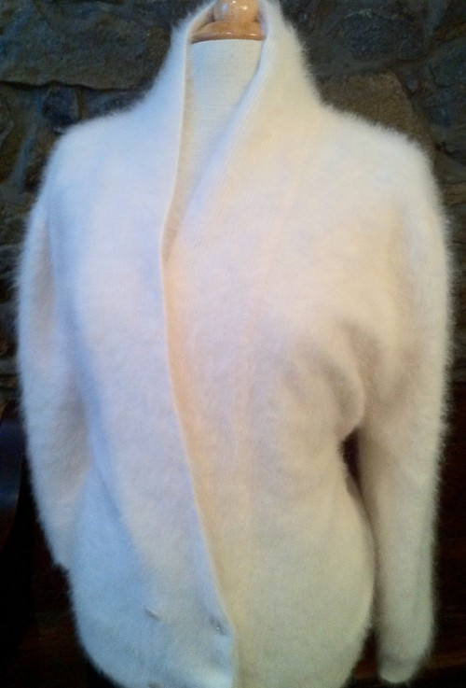
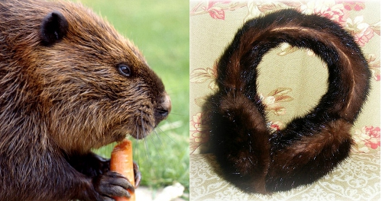

Slide 18
Identification of skin and fur
When we speak of fur, four key words are used to describe how the fur piece is constructed.
UNDERCOAT: This is where you find the denser/thicker hair near the skin of the animal
GUARD HAIRS: These are the shinier, more delicate hairs which lay over the undercoat. They are more aesthetically pleasing while the undercoat is the practical warmth layer.
PILE: The “pile” is used to describe the direction of the hair growth, i.e. “the pile grows inward from the tail or outward from the top of the belly to the bottom of the torso.”
PELT: The literal skin of the animal, and the phrase used to describe the number of animals needed to create one fur garment. “This fur coat required 10 pelts of a fox,” for example.

Slide 19
Skins are found in items in all shapes, sizes, and colors and come from many different animals, including mammals, birds, and fish. Identifying the animal origin of a skin can be easy or difficult, depending on how it was processed and used.
Frequently, the pelt has been minimally processed, and the fur or feathers have been left on, making the identification easier.
More commonly, however, the hair has been removed by chemical and physical processing.
Most skins are smooth, at least on one side, which is called the hair or grain side. The other, rough, felted surface is called the flesh side.
To identify these highly processed skins, you have to look closely at the grain pattern, which is formed by hair follicles (holes) where the hair grew.

Slide 20
Identification of bones and teeth
The bones are distinct in each class of vertebrates and is a first clue to which animals the skulls belong to.
Another way for identifying skulls is through the teeth.
Herbivores, animals that eat only plants, have flat teeth"molars"made for grinding food before swallowing.
Canines hold pray while carnassials are used for tearing and ripping flesh. Omnivores have both canines and molars of which humans are a prime example.
Antlers and horns help to identify the type of bovid they belong to, and the gender as well because for the most part female bovid do not grow antlers.

